Slide 1
Lending Club Case Study
Anshul Sarswat
Ankit Gayen

Slide 2
LENDING CLUB ANALYSIS OVERVIEW
IDENTIFING BUSINESS PROBLEM
DATA DESCRIPTION
DATA PRESENTATION AND PROCESSING
MODELS
SUMMARY OF FINDINGS
CONCLUSION

Slide 3
BUSINESS UNDRESTANDING
We are working for Lending club a finance company which specialises in lending various types of loans to urban customers. When the company receives a loan application, the company has to make a decision for loan approval based on the applicant’s profile. Two types of risks are associated with the bank’s decision: •If the applicant is likely to repay the loan, then not approving the loan results in a loss of business to the company •If the applicant is not likely to repay the loan, i.e. he/she is likely to default, then approving the loan may lead to a financial loss for the company

Slide 4
OBJECTIVE
The company wants to understand the driving factors (or driver variables) behind loan default (loan_status = 'Charged Off'), i.e. the variables which are strong indicators of default. The company can utilise this knowledge for its portfolio and risk assessment.

Slide 5
DATA CLEANING
DROP THE NULL/ADDITIONAL COLUMNS BASED ON ANALYSIS
LEFT WOTH 44 COLUMNS
CONVERT ALL VALUES INTO NUMETIC VALUES FOR BETTER CALCULATIONS
OBSERVATIONS
Fully Paid 82.96
Charged Off 14.17
Current 2.87
Name: loan_status, dtype: float64

Slide 6
DATA CLEANING
ANALYSIS PF PURPOSE OF LOAN
Most of the loans taken for debt consolidation(47%) and Credit card bill payment.
Other is also one of the main area where loans were taken.
Derive Columns For Analysis
Two new columns month and year were derived from issue date

Slide 7
UNIVARIATE ANALYSIS
REMOVE OUTLIERS QUANTITILE 0.00 FROM ANNUAL INCOME
ANALYSIS
AVERAGE % RATE IS 12%
AFTER 75% PERCENTILE INTEREST RATE ZOOMED TO 25% FROM 15%

Slide 8
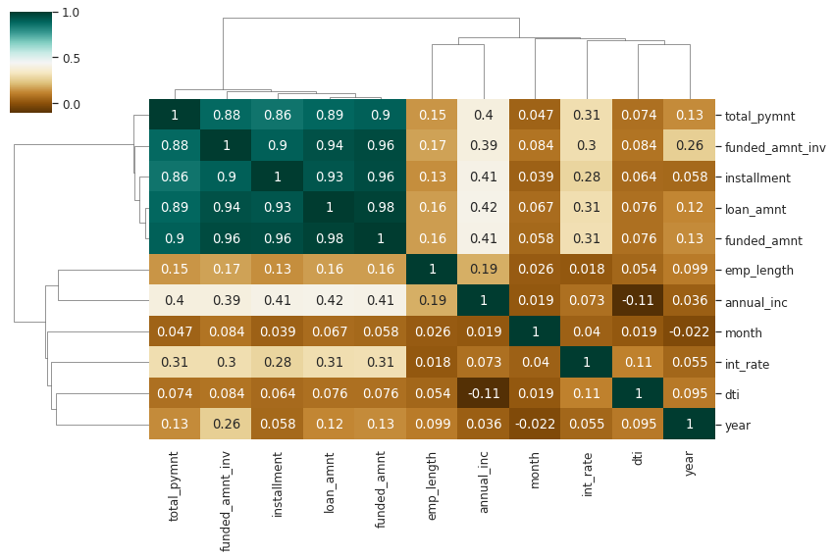
BIVARIATE ANALYSIS
Correlation Matrix-Quantitative Variable
Heatmap with Dendogram (clustermap) to show closeness among numerical variables.

Slide 9
BIVARIATE ANALYSIS
Observation is that Loan amount, investor amount, funding amount are strongly correlated.
Annual income with DTI(Debt-to-income ratio) is negatively correalted.
Debt income ratio is the percentage of a consumer's monthly gross income that goes toward paying debts.
That means when annual income is low DTI is high & vice versa.
positive correlation between annual income and employment years. # That means income increases with work experience.

Slide 10
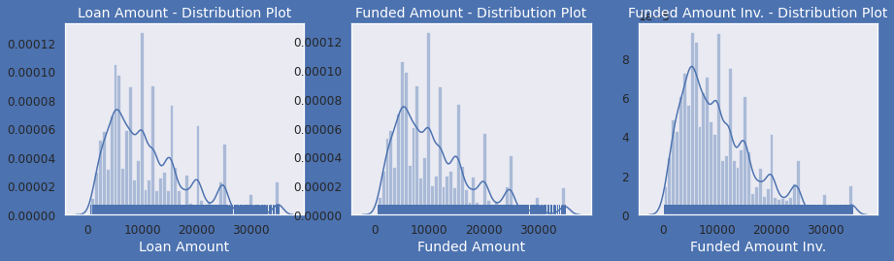
UNIVARIATE ANALYSIS
Observation:
Distribution of amounts for all three looks very much similar.
We will work with only loan amount column for rest of our analysis.

Slide 11
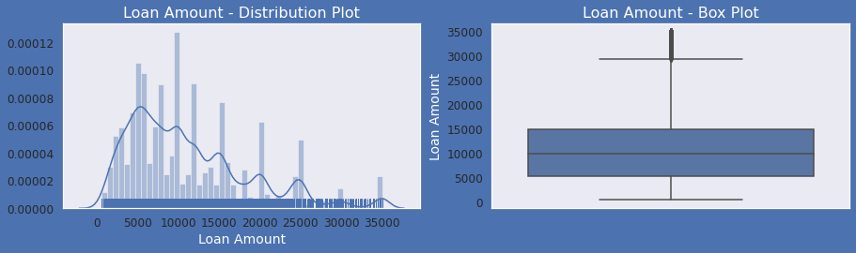
Univariate Analysis on Loan amount-Quantitative Variables
Observations :
Above plots show that most of the Loan amounts are in range of 5000 - 15000

Slide 12
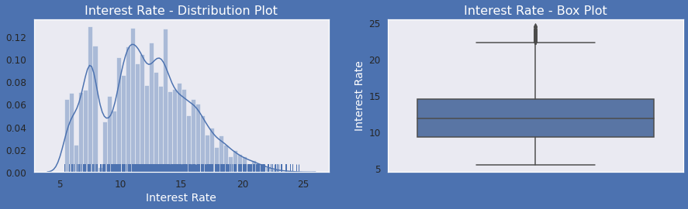
Univariate Analysis on Intrest Rate-Quantitative Variables
Observations :
Above plots show that most of the Interest Rates on loans are in range of 10% - 15%

Slide 13
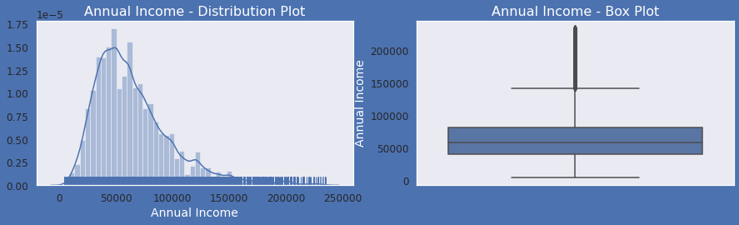
Univariate Analysis on Annual Income - Quantitative Varia
Observations : # Below plots show that most of the borrower's Annual incomes are in range of 40000- 80000
Observations :
Below plots show that most of the borrower's Annual incomes are in range of 40000- 80000

Slide 14
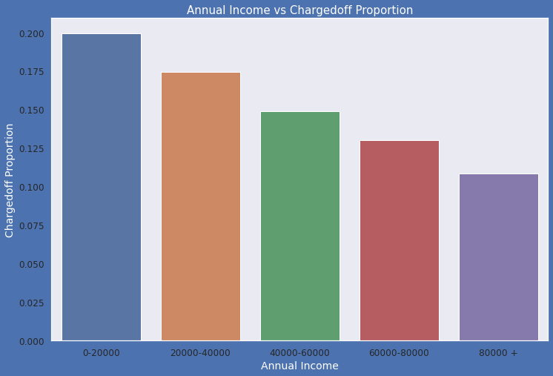
Bivariate Analysis : Part 1
Observations:
Income range 80000+ has less chances of charged off.
Income range 0-20000 has high chances of charged off.
Notice that with increase in annual income charged off proportion got decreased.

Slide 15
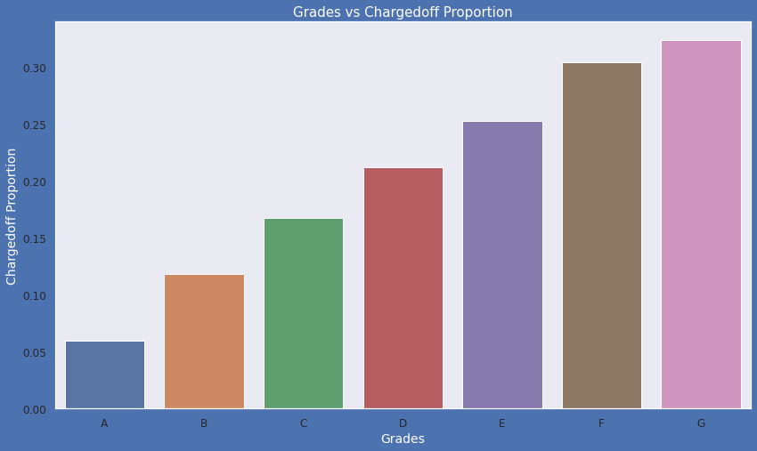
Observations:
Grade "A" has very less chances of charged off.
Grade "F" and "G" have very high chances of charged off.
Chances of charged of is increasing with grade moving from "A" towards "G"

Slide 16
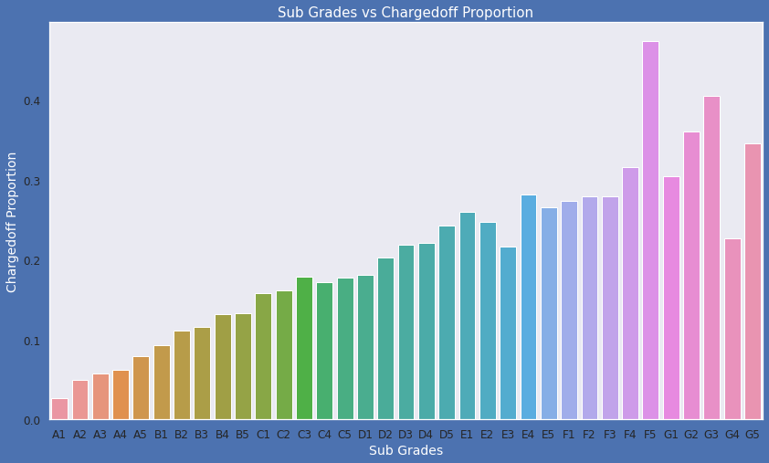
Bivariate Analysis on sub grade against Chargedoff_Proportion
Observations:
sub Grades of "A" has very less chances of charged off.
sub Grades of "F" and "G" have very high chances of charged off.
proportion of charged off is increasing with sub grades moving from sub grades of "A" towards sub grades of "G"

Slide 17
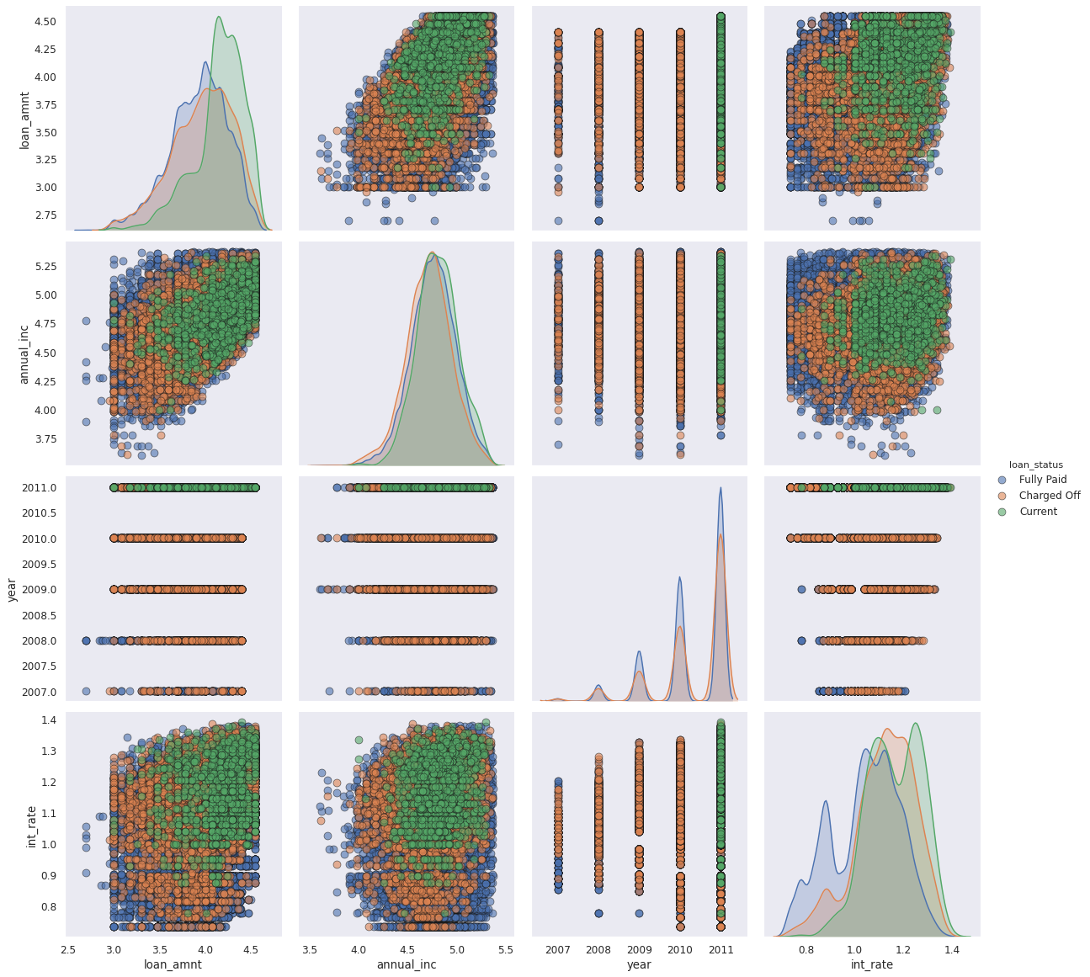
Multivariate Analysis - Pair Plots
Observation:
Higher the intrest rate higher charged off ratio #
Higher the annual income higher the loan amount slightly. # increase in number of charged off with increase in year.
intrest rate is increasing with loan amount increase

Slide 18
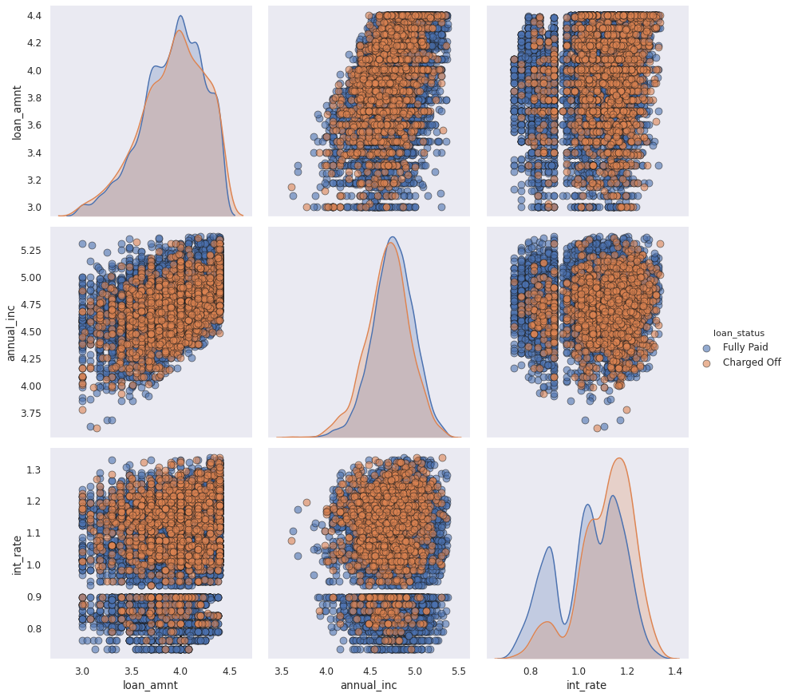
Above plot is too dense so just pick year 2010 for getting some insights.
Observation:
Higher the intrest rate higher charged off ratio # Higher the annual income higher the loan amount slightly
Intrest rate is increasing with loan amount increase this results in high charged off.

Slide 19
OBSERVATIONS
Minor Impact .Higher loan amount (above 16K) •Higher installment amount (above 327) •Lower annual income (below 37K) •Higher debt to income ratio (above 15%) •Applicant’s address state (NV, SD, AK, FL, etc.) •Loan issue month (Dec, May, Sep)

Slide 20
OBSERVATIONS
Heavy impact •Higher interest rate (above 13%) •Higher revolving line utilization rate (above 58%) •Repayment term (5 years) •Loan grade & sub-grade (D to G) •Missing employment record •Loan purpose (small business, renewable energy, educational) •Derogatory public records (1 or 2) •Public bankruptcy records (1 or 2)

Slide 21
OBSERVATIONS
Combined impact •High loan amount & interest rate for lower income group •High installment and longer repayment term •Home ownership (other) and loan purpose (car, moving or small business) •Residential state and loan purpose •Income group and loan purpose

